Slide 1
DATA VISUALIZATION ON LANDMARK ISSUES
WEB/MOBILE PROGRAMMING
Navya gonuguntla
MADHURI SARDA
JAYAPRAKASH RAVELLA

Slide 2
Content
Introduction
Motivation
Platform/Tools/Languages involved
Work Done So Far
Future Work In Increment-2

Slide 3
Landmark Issues?
There are a set of rules that each construction should abide by.
These are a set of rules that differ from a city to city
If these rules are broken, then it is called a violation.
There can be a series of landmark violations ranging from burglary, robbery, trespassing etc.

Slide 4
Motivation
It is particularly important to consider landmark violations
Driven personal motivation of being daunted by out landlord for not following landmark rules and regulations properties.
Drove us in learning more about landmark properties and use the data available on the internet and make the most interesting and useful analytics out of it.

Slide 5
Motivation (Contd.)g
Every city has its own rules and regulations that the citizens of the state needs to abide by.
Fetching the data from the internet about landmark violations and making useful analysis would actually help us to understand information regarding crime rate, hygiene conditions and many other factors of a neighborhood

Slide 6
Platform/Tools/Languages involved
HTML, CSS
JavaScript, AngularJS
Microsoft Visual Studio Code IDE

Slide 7
Datasets Used
The following datasets are being used for making API calls,
Census agency has demographic survey of United States citizens from 2010 to 2019. It is American Community Survey dataset. It contains the needed demographic information such as race, age and gender of people living locality wise (zipcode wise).
https://www.census.gov/data/developers/data-sets/acs1year.html
Data.gov is the federal government’s open data site. We are using information provided by this website to fetch data.
https://www.data.gov/open-gov/

Slide 8
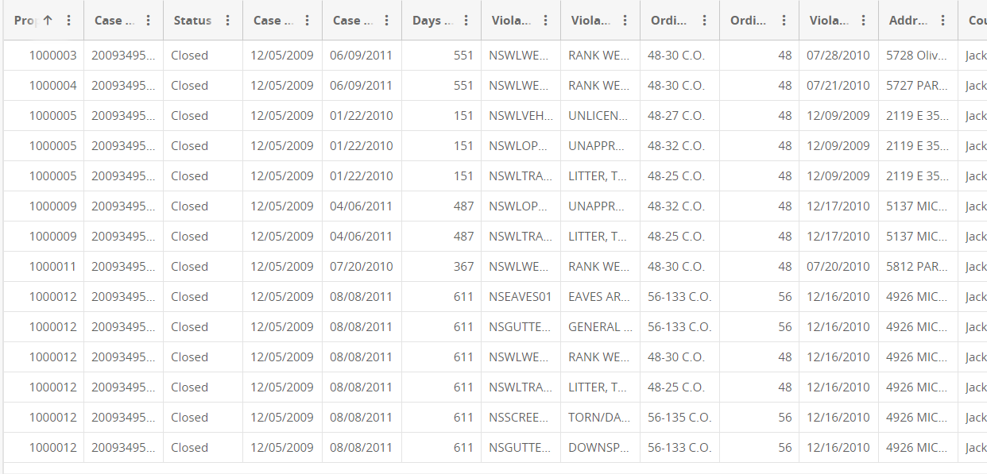
Sample Data

Slide 9
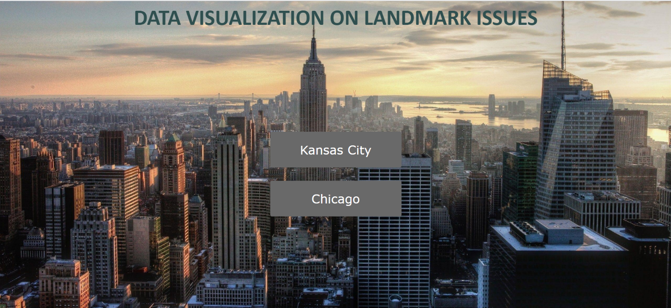
Homepage

Slide 10
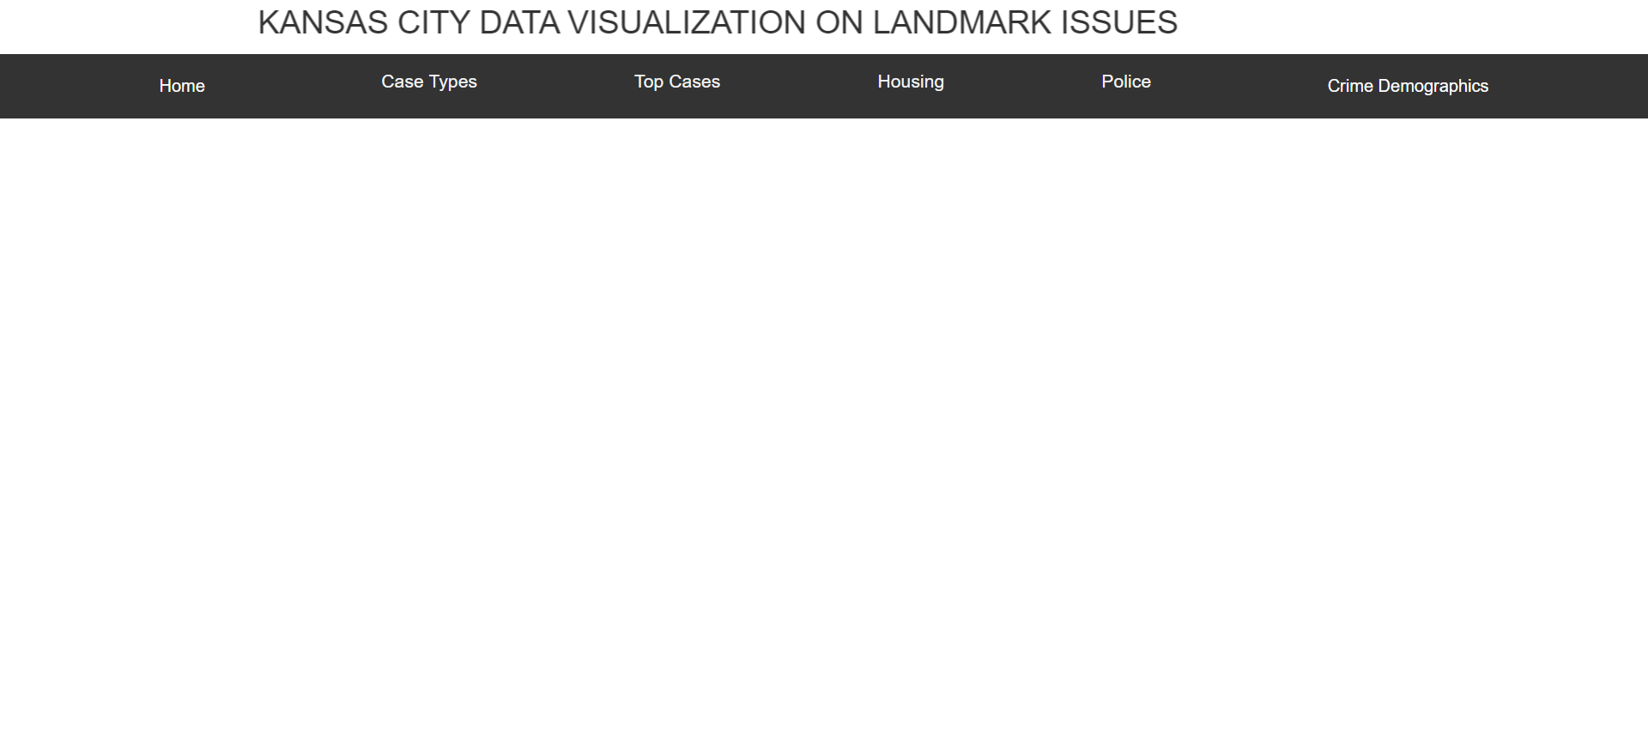
Homepage (Cont)
There are two buttons designed. Clicking on the city’s name would redirect to a new page that displays a series of valuable and useful information.

Slide 11
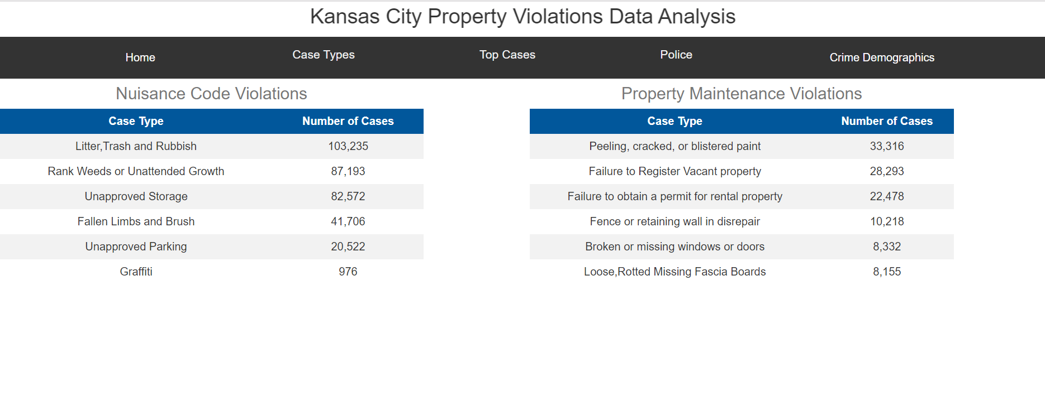
Types of property violation cases in KC
Property violations are divided into two different categories
Nuisance Code Violations
Property Maintenance Violations

Slide 12
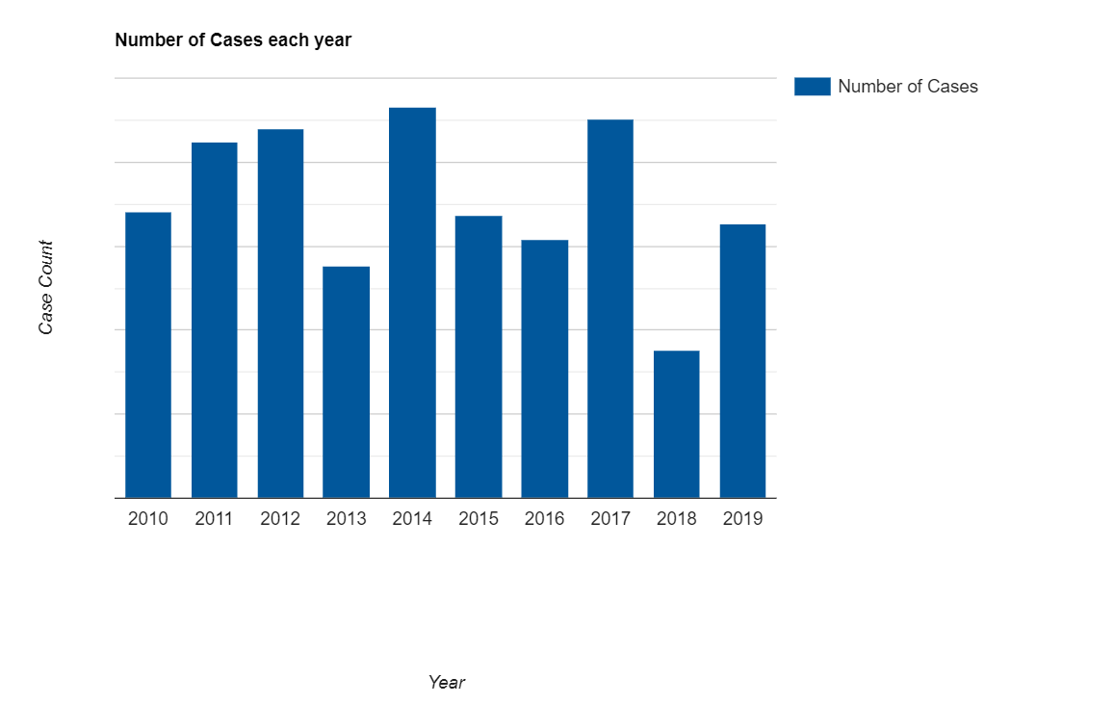
Number of cases filed from 2010 to 2019
Highest number of property violation cases are recorded in the year 2014 (93,016 cases) while the least were observed In the year 2018 (35,241 cases). There was a fluctuation in the total number of property violations filed in the last decade.

Slide 13
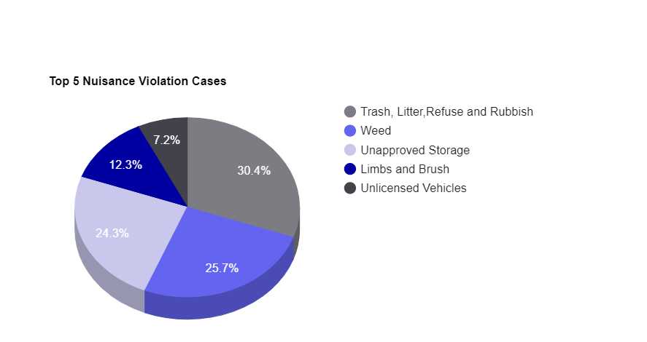
Top 5 nuisance violation cases
The following pie chart signifies the top 5 nuisance cases that takes place the most.

Slide 14
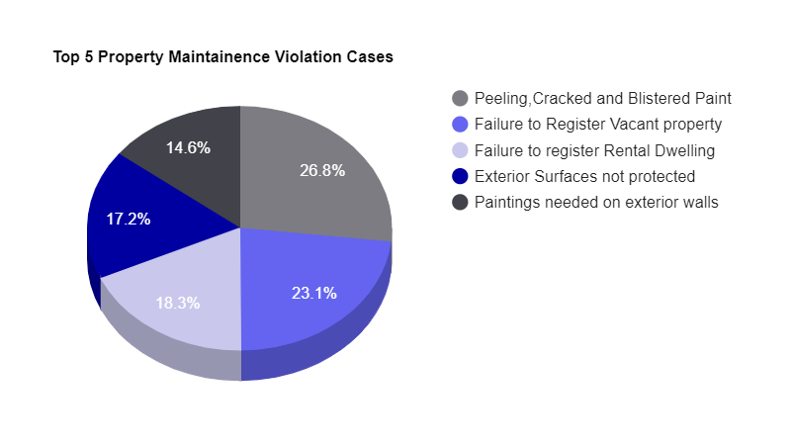
Top 5 property maintenance violation cases
The following pie chart signifies top 5 property maintenance violation cases filed

Slide 15
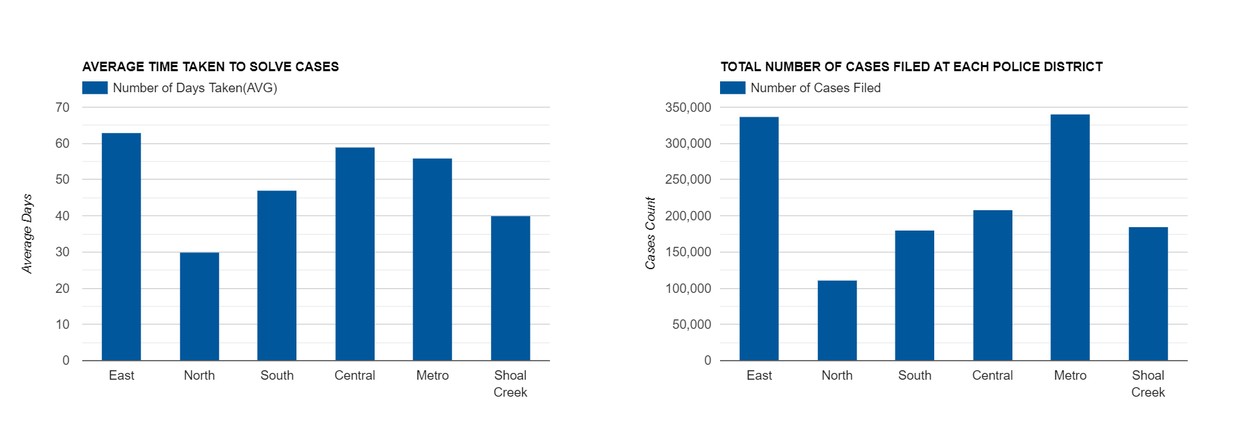
Time taken by each police district to solve cases and total number of cases filed at each police district
The following column charts depict the average number of days taken by each police district to solve violation cases and total number of cases filed at each police district. It can be observed that although the number of crimes are quite less at central (208687 cases solved in an average of 59), the average time taken by central to solve cases is high. Also Metro (340,572 cases solved In an average of 56 days) works relatively well considering the number of cases filed there.

Slide 16
Thank You!

